Slide 1
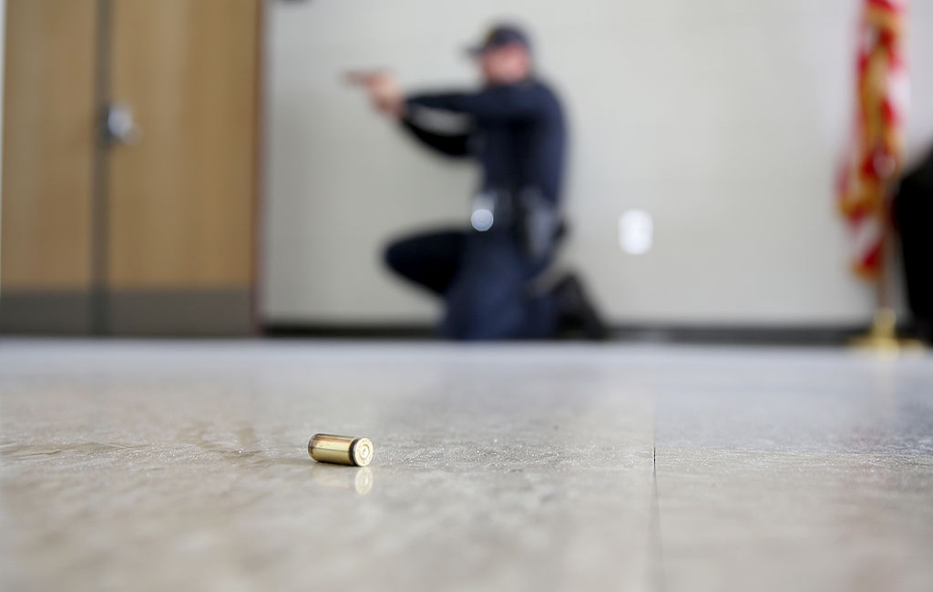
California Active Shooter preparedness
Presented by
Lindon Lilly ,Certified Trainer

Slide 2
Lindon Lilly
Retired Law Enforcement Supervisor with almost 20 years of service with another 35 years of experience in Legal support Services and Security Services Industry .
Numerous Letters of Recognition and years of specialized training
Has been recognized by California State Assembly
Member of International Association of Chiefs of Police
Remains personally driven to protect others and teach them the tools to protect themselves .

Slide 3
Acts of Violence
It's sickening that we must take measures to prepare for despicable acts of violence. Unfortunately, it's a fact of our times and we can't stick our heads in the sand thinking it would never happen at my place of business.
We All Must Prepare.

Slide 4
Today's Agenda
Active Shooter Definition
Anatomy of an Active Shooter
Active Shooter Events
Conditioning the Mind & Body to Stress

Slide 5
Today's Agenda
Drills and Rehearsals
Workplace Violence (OSHA)
Active Shooter Response A.I.D.
AVOID , INTERDICT , DEFEND

Slide 6
Today's Agenda
When Police and EMS Arrive
Post event Trauma
Questions

Slide 7
Active Shooter Definition
"An individual actively engaged in killing or
Attempting to kill people in a confined and
Populated areas"
.FBI

Slide 8
Active Shooter Definition
Victims selected at random
Events are unpredictable and evolve quickly
Knowing what to do can save lives

Slide 9

Anatomy of the Shooter
No set " Profile "
Mindset
Signals / Leakage

Slide 10
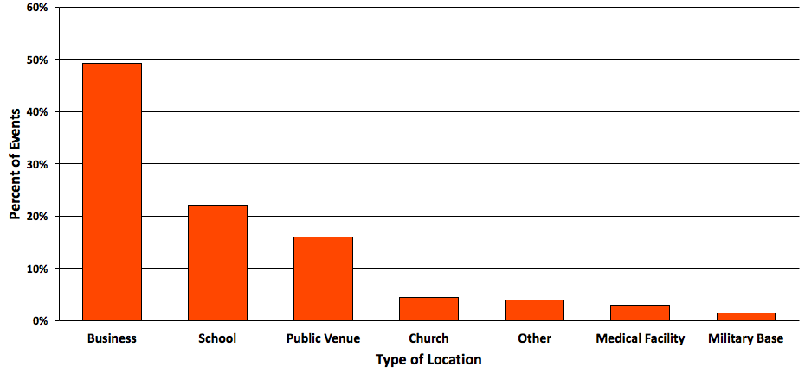
Active Shooter Events

Slide 11
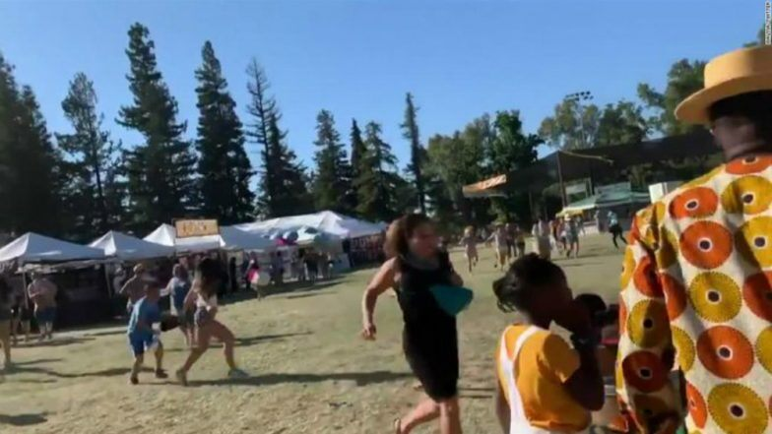
Gilroy Garlic Festival shooting July 28,2019
Shot & killed 3,wounded 13

Slide 12
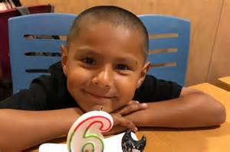
Youngest was a 6 yr. old Boy
Stephen Romero

Slide 13
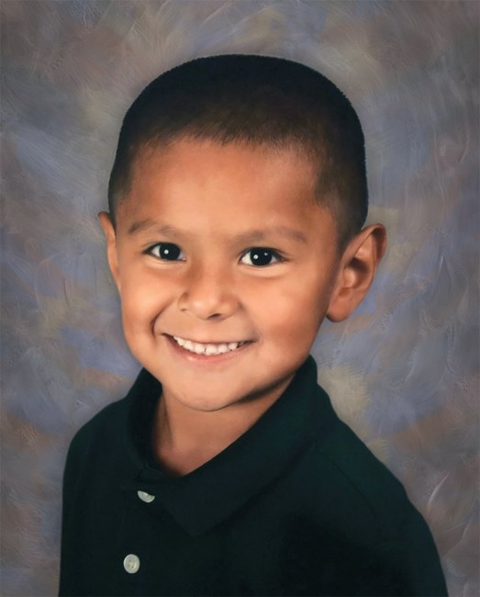
Stephen L . Romero
June 13, 2013 - July 28, 2019
He was a funny kid who always wanted to make everyone smile , play all day and make new friends.

Slide 14
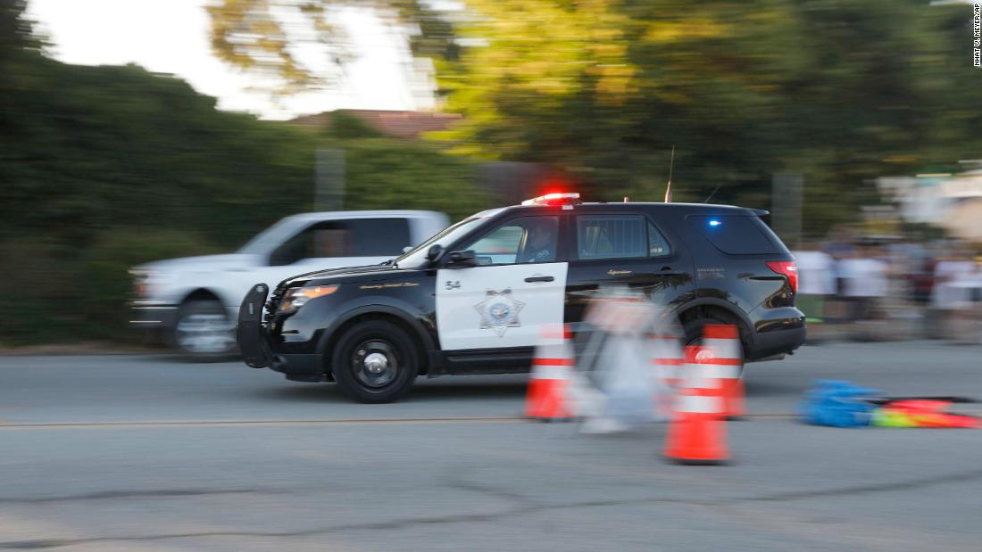
Officers responses time
one minute

Slide 15
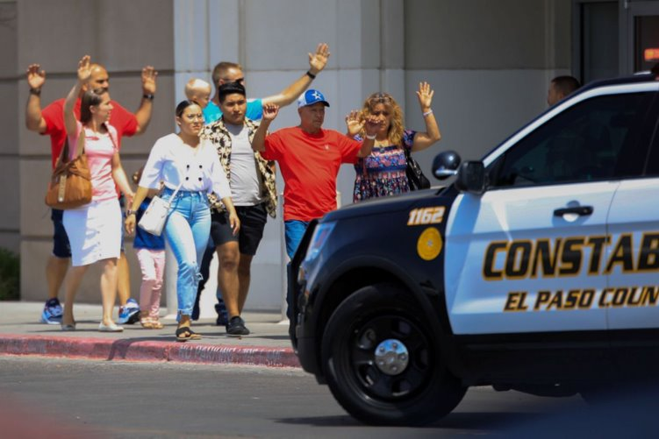
El Paso Walmart August 3, 2019

Slide 16
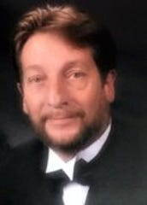
El Paso Walmart Ak-47 style assault rifle
David Alvah Johnson 63
Died protecting his wife and granddaughter
El Paso Times
Killed 22
Wounded 24
Shooter a 21 yr. old
White male
After shooting
surrendered to police and said "I'm the shooter".

Slide 17
David Alvah Johnson 63
David was a beloved and devoted husband ,father , and grandfather . He was a hardworking and very loved man and brother. A man who was always had a smile and laughter in his voice

Slide 18
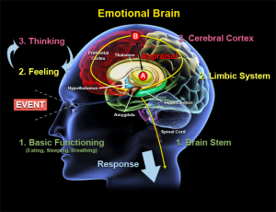
Conditioning the Mind & Body to Stress

Slide 19
Three Stages of Response
Denial
Deliberation
Decisive Moment

Slide 20

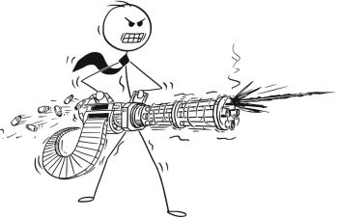
Denial

Slide 21
Denial
Don't deny .
Hearing gunshots ?
Go to "deliberation."

Slide 22

Denial
Don't deny .
Hearing gunshots ?
Go to "deliberation."

Slide 23

Deliberation Lizard brain

Slide 24
Decisive Moment
Be aware of your surroundings and make your decision.

Slide 25

Make Informed Decisions
Calm yourself.
Focused breathing.
Shift your emotions.

Slide 26
Drills and Rehearsals
• Script out
• Rehearse • Repeat
Practice Practice Practice

Slide 27
Workplace Violence (OSHA)
Workplace violence is any act or threat of physical violence, harassment, intimidation, or other threatening disruptive behavior that occurs at the work site. It ranges from threats and verbal abuse to physical assaults and even homicide. It can affect and involve employees, clients, customers, and visitors.

Slide 28
Workplace Violence
• Concepts and principles stay the same.
• Don’t underestimate Workplace Violence.
• Response options are the same toward an Active Shooter.

Slide 29
Active Shooter Response A.I.D.
AVOID , INTERDICT , DEFEND

Slide 30

AVOID , INTERDICT , DEFEND
Know your EXIT's.
Leave personal items.
LEAVE, if possible.
Call 911.

Slide 31
AVOID , INTERDICT , DEFEND
Avoid cubicles if you can, and make your way OUT of the building.
KEEP GOING.
If you can get to an office that has a lockable door.

Slide 32
AVOID , INTERDICT , DEFEND
Consider secondary exits.
Any way out of a building or structure that isn't a primary way of egress, for example :
2nd floor windows.
Exterior glass walls, etc.

Slide 33
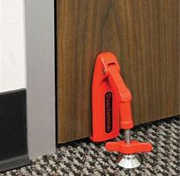
AVOID , INTERDICT , DEFEND
Turn off lights.
Lock the doors.
Remain quite.

Slide 34
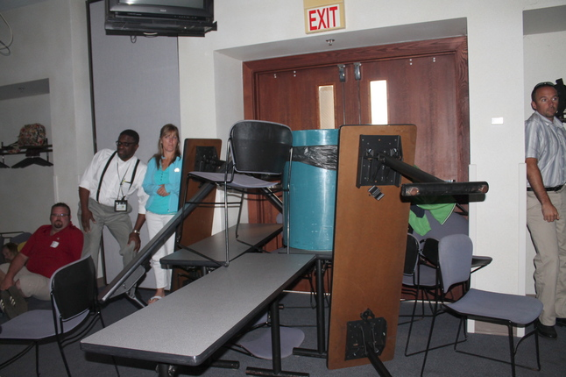
AVOID , INTERDICT , DEFEND
Inward opening doors :
Barricade door.
Heavier is better.
More is better.
Use door stops

Slide 35
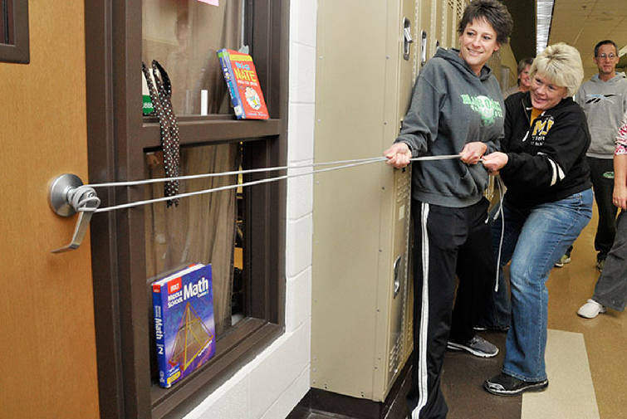
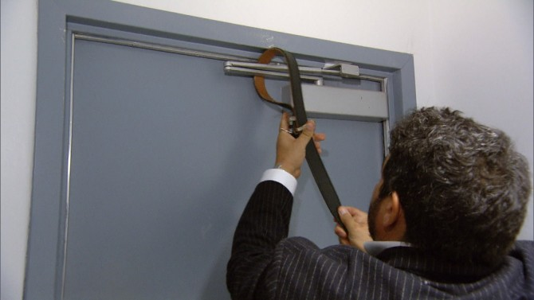
AVOID , INTERDICT , DEFEND
Outward opening doors.
Rope method.
Top hinge secure.

Slide 36
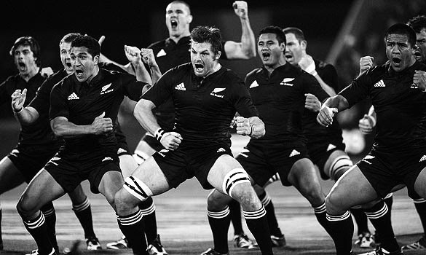
AVOID , INTERDICT , DEFEND
Remember, " Challenge " is the last resort.
Positioning is everything !
Grab the gun if it's your last option ; do not give up.
Be dedicated to your actions.
Remember your life is at stake !
author

Slide 37
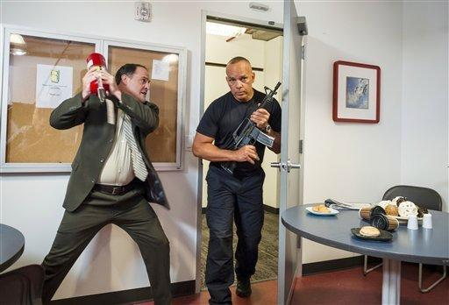
AVOID , INTERDICT , DEFEND
Incapacitate the shooter
Grab the gun if it's your last option ; do not give
Up.
Be dedicated to your actions.
Remember, your life is at stake !

Slide 38
Hunters &
Healers

Slide 39
When Police Arrive
Remain calm
Follow commands
Raise hands ; show your palms .
DO NOT MOVE !

Slide 40
When Police Arrive
Law Enforcement is not there to medically help casualties, right away.
Law Enforcement's primary goal is to stop the Active Shooter.
Hunters

Slide 41
When EMS Arrives
EMS may be delayed.
Ask if they need help.
Help evacuate people , if they ask.
Law Enforcement will be busy.
Healers

Slide 42
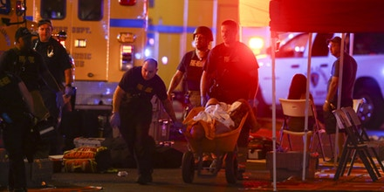
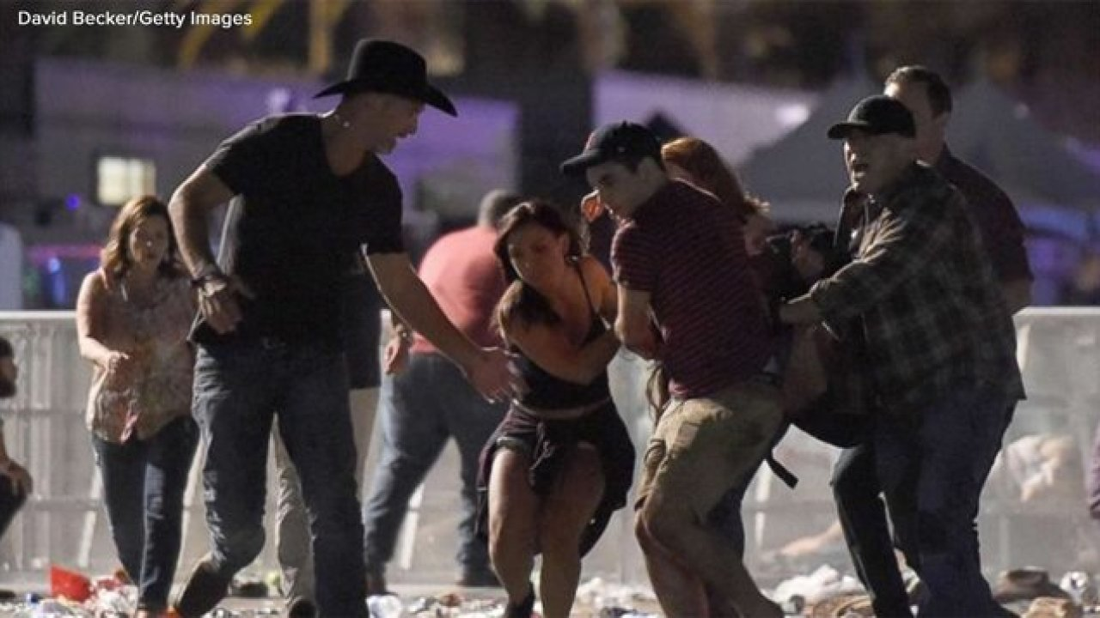
Las Vegas shooting October 2017

Slide 43
Las Vegas shooting October 2017
58 killed and hundreds more injured :
The crowd got involved, rendered aid, and helped transport victims away from the scene and to hospitals. "The crowd, in large part I think, helped contribute to how many lives were saved that night," said Craig Cooper, special operations chief of Las Vegas Fire Rescue." I'm really proud of the way that crowd responded . I think it's a shift in mindset for our country to start looking at ways we can help ourselves-not be victims to these things, but be empowered by the knowledge and the tools we have to help people in need no matter where or when an incident occurs. "

Slide 44
You are NOT helpless !

Slide 45
Questions ?
Comments ?

Slide 46
Thank You

Slide 47
Contact Lindon Lilly Director of Safety and Risk Mitigation
1-833-922-6742
Email:llilly@californiaactiveshootertraining.com
Website: www.californiaactiveshooter.com

